Slide 1


Project 1
AutoML algorithm for regression
Central European University
David Diestre Rubio • Juan Roset Moreno
DNDS5019 • Machine Learning (Advanced) | Winter 2026 | Nysret Musliu
Notes:
1

Slide 2



Presentation Overview
Our Algorithm
Data & Preprocessing
Results & Discussion
Repository organization
AutoML implementation
Machine Learning models
Chosen data sets
Data‘s Structure
Preprocessing pipeline
Overall Results
vs TPOT & auto-sklearn
Discussion & Lessons learned
DNDS5019 • Machine Learning (Advanced)
1
Notes:
2

Slide 3

Section I: Our algorithm
Repository, approach, ML models used, and neighbor states generation
DNDS5019 • Machine Learning (Advanced)
2
Notes:
3

Slide 4

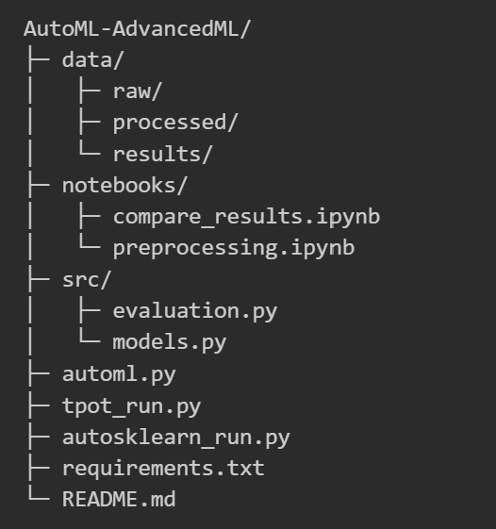
GitHub Repository
Workflow
raw
preprocessing.ipynb
processed
automl.py
results
compare_results.ipynb
DNDS5019 • Machine Learning (Advanced)
3
Notes:
9

Slide 5
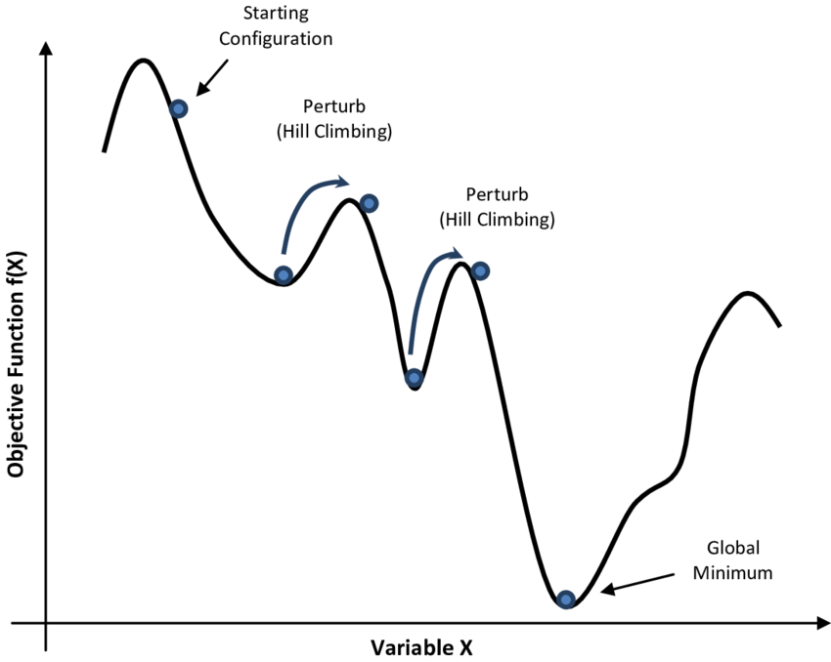
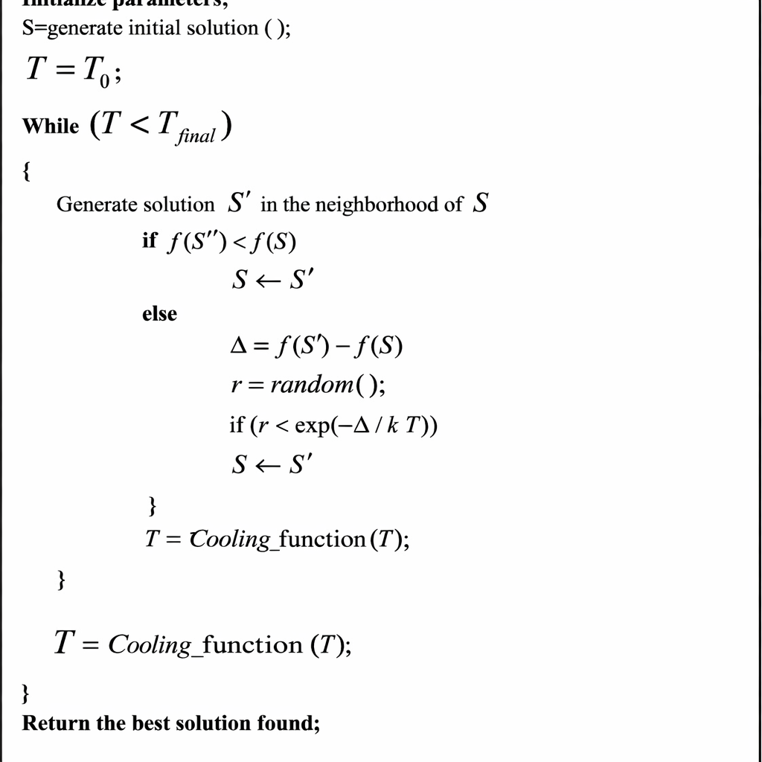
Simulated annealing
https://www.researchgate.net/figure/The-pseudo-code-of-simulated-annealing-algorithm_fig2_309537833
https://www.cs.us.es/~fsancho/Blog/posts/Simulated_Annealing_in_NetLogo.md
DNDS5019 • Machine Learning (Advanced)
4
Notes:
5

Slide 6
Simulated annealing, but with a twist
Problem
If we consider all neighbor states equiprobable, the probability of a model being changed depends on how many possible hyperparameter neighbor states each specific model allows.
Solution
Initial probabilistic choice on each iteration between change of models vs change of hyperparameters.
DNDS5019 • Machine Learning (Advanced)
5
Notes:
5

Slide 7
Simulated annealing, but with a twist
Problem
Problem
If we consider all neighbor states equiprobable, the probability of a model being changed depends on how many possible hyperparameter neighbor states each specific model allows.
On the first iteration, each model’s initial configurations may yield high errors, making it hard to explore models that might have great potential when finely tuned.
Solution
Solution
Initial probabilistic choice on each iteration between change of models vs change of hyperparameters.
Higher temperature factor for model changes.
DNDS5019 • Machine Learning (Advanced)
5
Notes:
5

Slide 8
Simulated annealing, but with a twist
Problem
Problem
Problem
If we consider all neighbor states equiprobable, the probability of a model being changed depends on how many possible hyperparameter neighbor states each specific model allows.
On the first iteration, each model’s initial configurations may yield high errors, making it hard to explore models that might have great potential when finely tuned.
Simulated annealing ends when the temperature is below T_min. If T decreases with iterations, we can’t control the time we run the algorithm for.
Solution
Solution
Solution
Different temperature factor for model changes
Initial probabilistic choice on each iteration between change of models vs change of hyperparameters.
Higher temperature factor for model changes.
Temperature factor decreases with time.
DNDS5019 • Machine Learning (Advanced)
5
Notes:
5

Slide 9
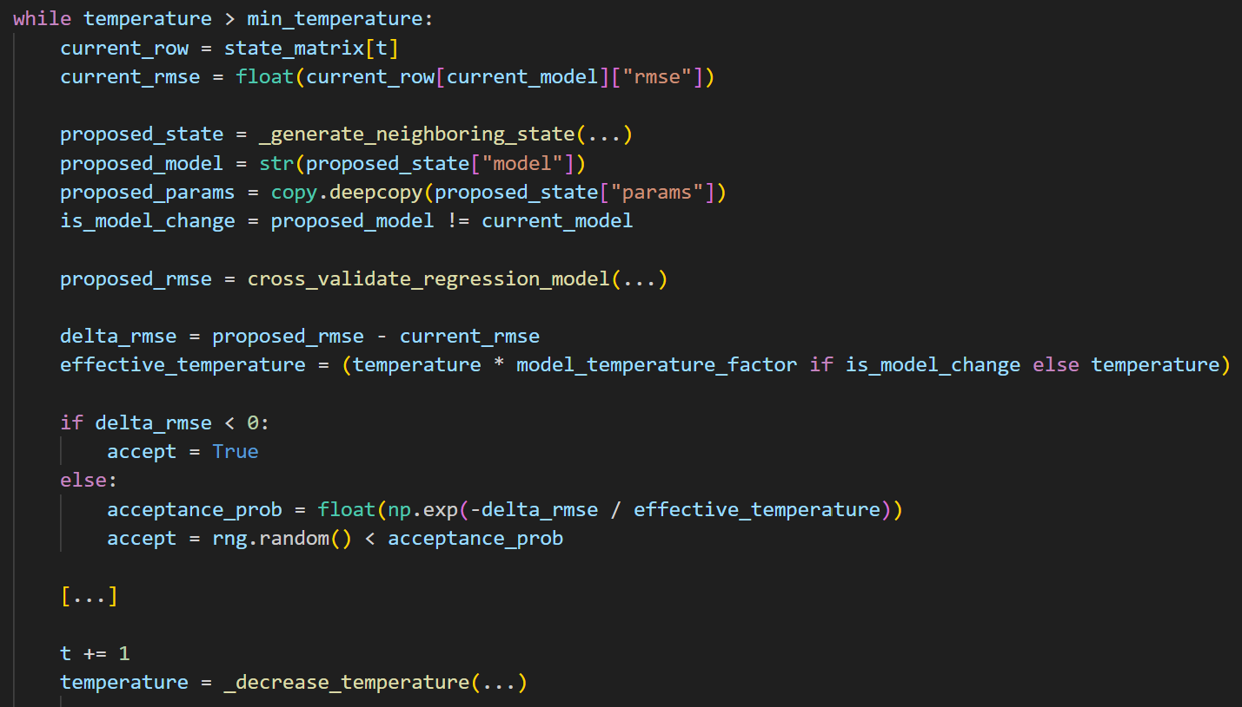

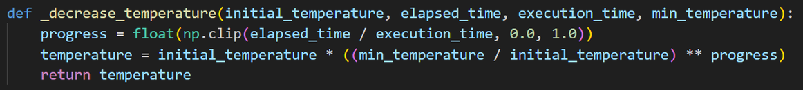
Simulated annealing, but with a twist
Core idea of our simulated annealing algorithm
Probabilistic choice between change of models vs change of hyperparameters
Decreases
with time
DNDS5019 • Machine Learning (Advanced)
6
Notes:
4

Slide 10
Machine Learning models
Polynomial Regressor
KNN
Random Forest
MLP Regressor
Hyperparameters
max degree
model complexity
degree mask
active polynomial orders
regularization
prevent overfitting
alpha
log-scale moves
Hyperparameters
num neighbors
controls bias-variance
weights
uniform or distance
geometric distance
Manhattan or Euclidian
Hyperparameters
num estimators
variance reduction
max depth
structure complexity
min samples leaf
regularitzation
max features
diversity and randomness
Hyperparameters
hidden layer size
architecture and complexity
alpha
weight regularitzation
learning rate
speed and stability
activation
tanh or relu functions
DNDS5019 • Machine Learning (Advanced)
7
Notes:
15

Slide 11
Local Neighborhood Design
Polynomial Regressor
KNN
Random Forest
MLP Regressor
New Neighbor state
60% flip one order in degree mask to turn degree on/off
15% change regularitzation among None, Lasso or Ridge
15% move alpha in log-space
10% change degree in max degree by +1 or -1
New Neighbor state
70% move num neighbors by steps depending on the scale of the data, the steps can be small, normal or large
15% toggle weights between unifrom and distance
15% toggle distance p between Manhattan and Euclidian
New Neighbor state
25% change num estimators by +10 or -10
40% move max depth by +1 or -1, sometimes toggle to None
20% move min samples leaf by +1 or -1
15% toggle max features between sqrt, log, 0.5 and 1
New Neighbor state
70% to change hidden layers, but it only adds or removes one layer with 35% of the times
12% alpha moves in log-space
8% learning rate moves in log-space
10% toggle activation between relu and tanh functions
DNDS5019 • Machine Learning (Advanced)
8
Notes:
15

Slide 12
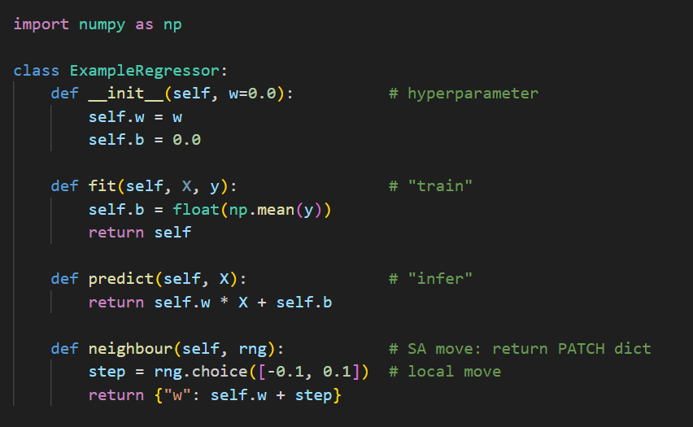
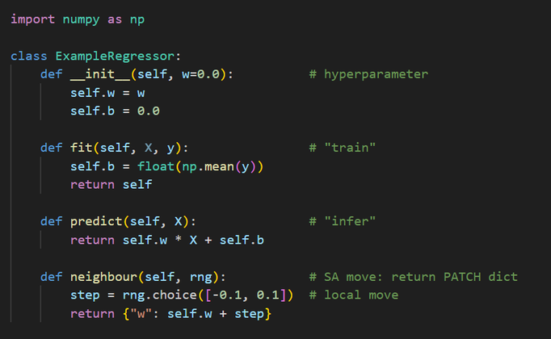
Model Regressor example
Core Idea (models as classes)
Fit function
Uses the model library to train a dataset
Predict function
Uses the model library after fit function to predict the target value of a dataset
Neighbour function
Generates a new local neighbor of the hyperparameters and it returns those new hyperparameters in a dictionary
DNDS5019 • Machine Learning (Advanced)
9
Notes:
8

Slide 13

Section II: Data & Preprocessing
Datasets used, their sizes, and preprocessing
DNDS5019 • Machine Learning (Advanced)
10
Notes:
3

Slide 14


Data Sets
Cosmic Stability Index
Superconductivity Data
• Kaggle data set (Regression Challenge)
• 10,000 rows
• 14 features
Target: Stability Index
Source: https://www.kaggle.com/competitions/tda-aiml-cosmic-stability-problem-0f3ebc/overview
• UCI data set
• 21,263 rows
• 82 features
Target: Critical Temperature
Source:
https://archive.ics.uci.edu/dataset/464/superconductivty+data
DNDS5019 • Machine Learning (Advanced)
11
Notes:
4

Slide 15
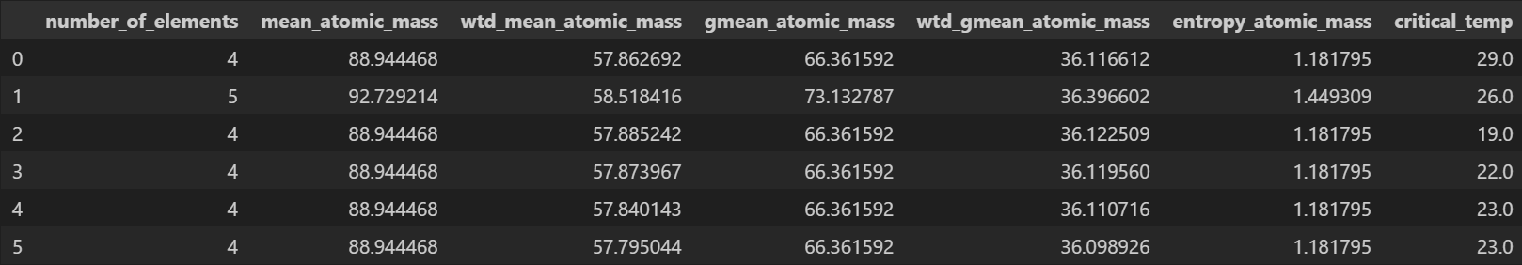
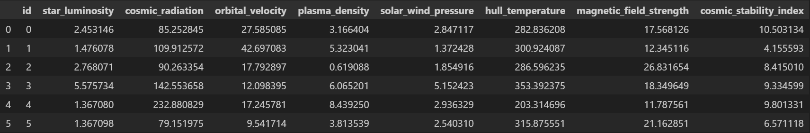
Data Sets
Cosmic Stability Index
Superconductivity Data
DNDS5019 • Machine Learning (Advanced)
12
Notes:
4

Slide 16
Data Preprocessing
Remove Duplicates & Irrelevant Features
Columns with the same info and values
Columns with unnecessary info (index, id, or NULL columns)
Missing Values
Change missing values with average or majority attribute of the column
Pipelines for ML models
StandardScaler() - For numerical features
OneHotEncoder() - For categorical features
DNDS5019 • Machine Learning (Advanced)
13
Notes:
4

Slide 17
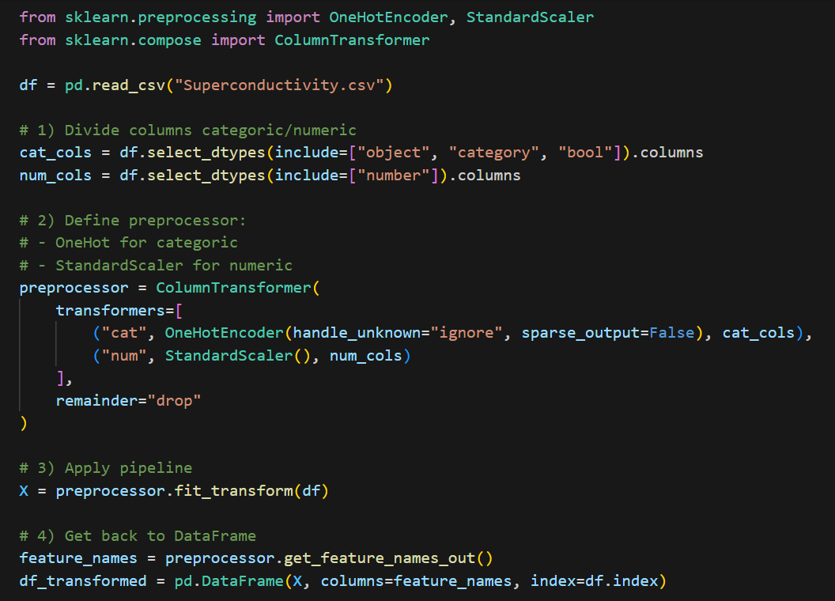

Data Preprocessing
Remove Duplicates & Irrelevant Features
Columns with the same info and values
Columns with unnecessary info (index, id, or NULL columns)
Missing Values
Change missing values with average or majority attribute of the column
Pipelines for ML models
StandardScaler() - For numerical features
OneHotEncoder() - For categorical features
DNDS5019 • Machine Learning (Advanced)
13
Notes:
4

Slide 18

Section III: Results & Discussion
How did we perform against TPOT and auto-sklearn?
DNDS5019 • Machine Learning (Advanced)
14
Notes:
3

Slide 19
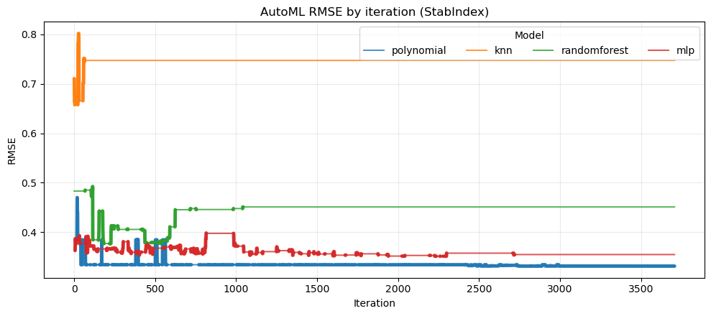
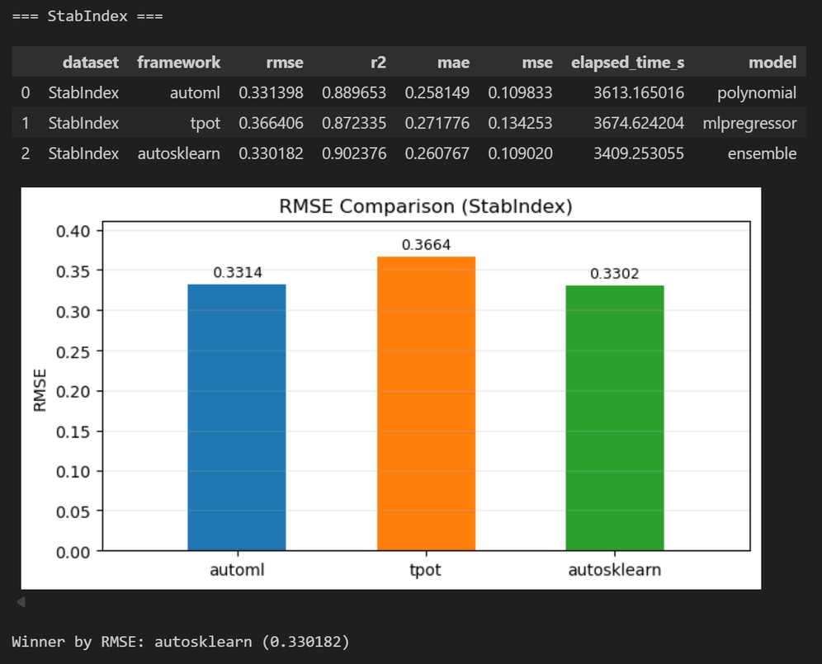
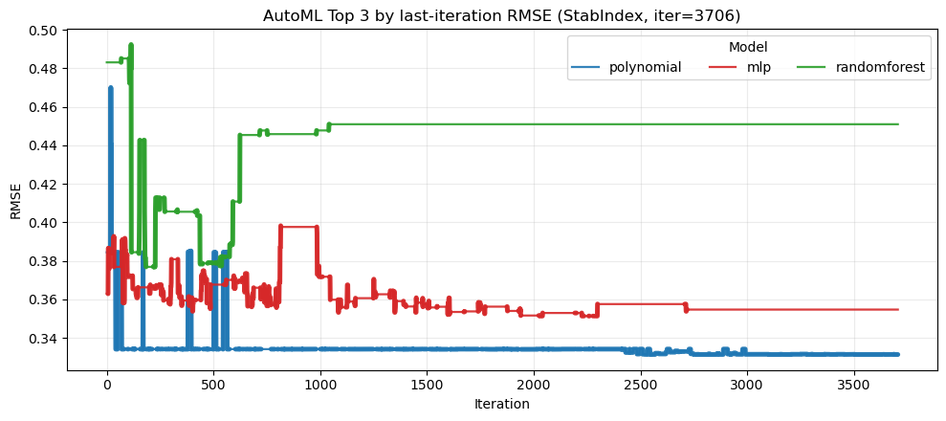
Results - StabIndex
DNDS5019 • Machine Learning (Advanced)
15
Notes:
5

Slide 20
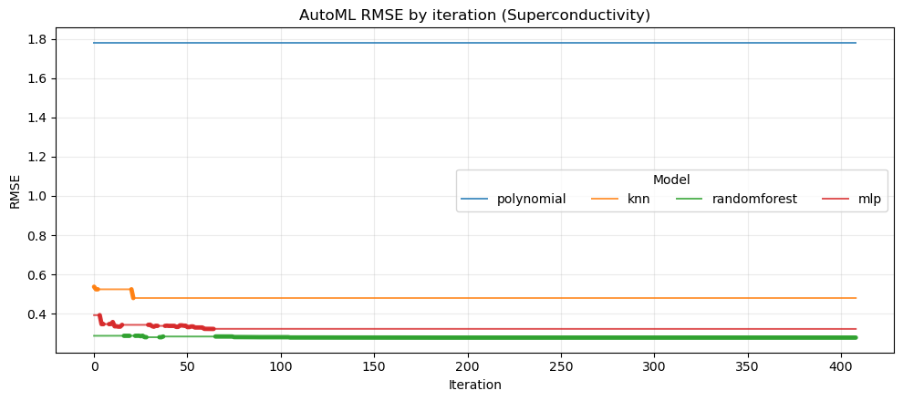
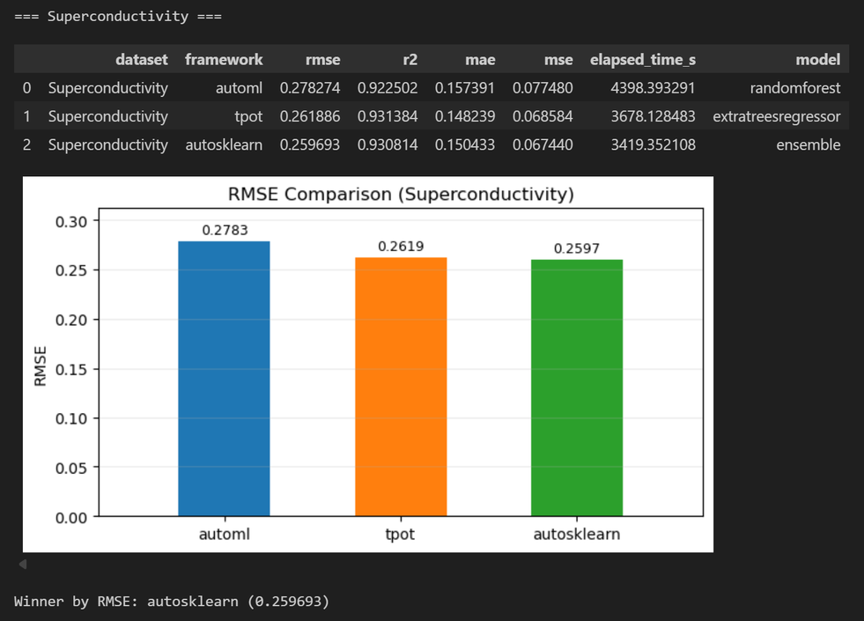
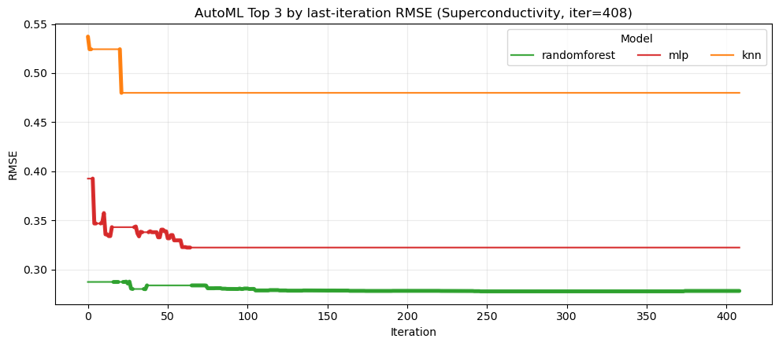
Results - Superconductivity
DNDS5019 • Machine Learning (Advanced)
16
Notes:
5

Slide 21

Discussion
Conclusions
Difficulties
Very strong results which can surpass automl models such as TPOT, and are very close to auto-sklearn.
Our models diverge on first iterations → good exploration
Our curves stabilize → good exploitation
Our results supports No free lunch theorem, since performance depends on dataset characteristics:
StabIndex Lower dimensional (Polynomial Regressor)
Superconductivity Higher dimensional (RF)
Choosing datasets for regression
Different preprocessing steps for each dataset
Tuning of automl parameters: Diverse tests on parameters such as temperature and probability of changing models
Managing model neighbor function
DNDS5019 • Machine Learning (Advanced)
17
Notes:
11

Slide 22
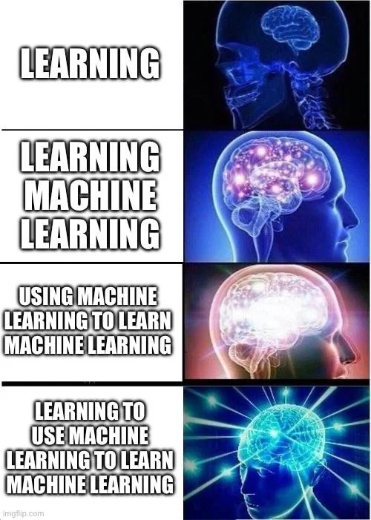
Lessons Learned
Both of us learned how to implement automl algorithms, designing a search model based on simulated anneling from scratch.
We have observed that distinct datasets prefer different model biases, which supports the No Free Lunch Theorem.
It’s not always about the model. Hyperparameter tuning is also a key part of any ml project, and many thought should be poured into it. Even when using an AutoML algorithm.
With great power comes great responsibility. We shouldn’t abuse automl. Machine learning is 80% about understanding the problem. Automl is a helpful tool, but not one that should keep us from thinking.
DNDS5019 • Machine Learning (Advanced)
18
Notes:
11

